Slide 1
Network Layer: Classless IP Addressing
Covers Chapter#18 from Text Book
Computer Communication & Networks
(CEN-223)
Fall 2022 (BSE-5A)

Slide 2
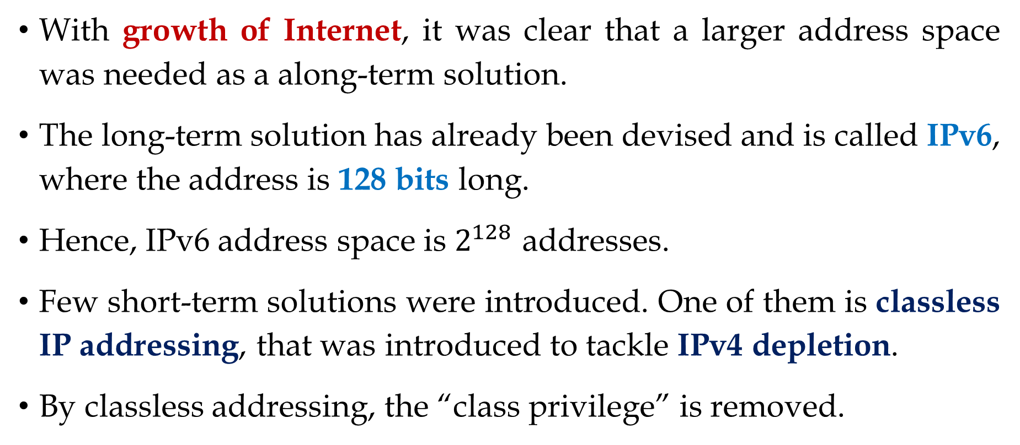
Classless Addressing
With growth of Internet, it was clear that a larger address space was needed as a along-term solution.
The long-term solution has already been devised and is called IPv6, where the address is 128 bits long.
Hence, IPv6 address space is $2^{128}$ addresses.
Few short-term solutions were introduced. One of them is classless IP addressing, that was introduced to tackle IPv4 depletion.
By classless addressing, the “class privilege” is removed.

Slide 3
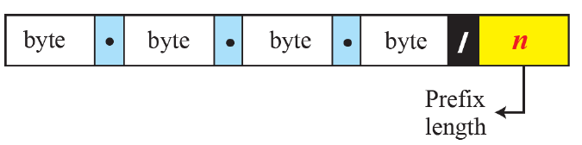
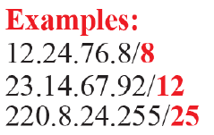
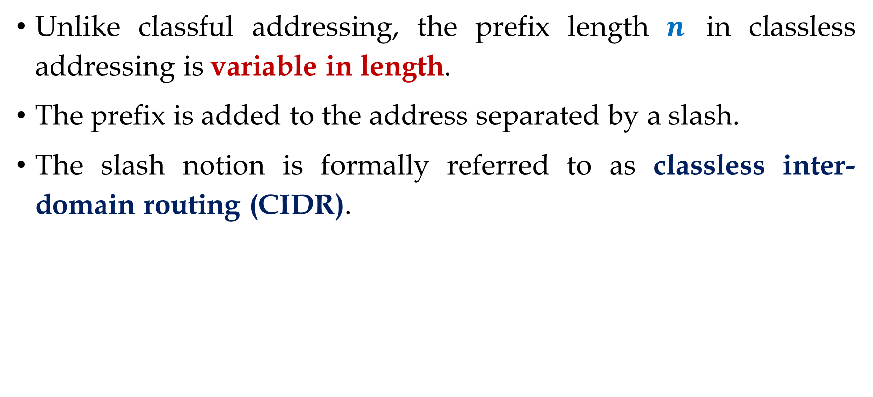
Classless Addressing (Cont.)
Unlike classful addressing, the prefix length $n$ in classless addressing is variable in length.
The prefix is added to the address separated by a slash.
The slash notion is formally referred to as classless inter-domain routing (CIDR).

Slide 4
Classless Addressing (Cont.)
Advantage; it can create multiple networks using a single network address.
In classless addressing, maximum subnet mask could be /30 for keeping 2 bits for host IP address.
As shown previously:
Class A default subnet mask /8
Class B default subnet mask /16
Class C default subnet mask /24

Slide 5
Classless Addressing (Cont.)
Subnet Mask | CIDR Value
255.0.0.0 | /8
255.128.0.0 | /9
255.192.0.0 | /10
255.224.0.0 | /11
255.240.0.0 | /12
… | …
255.255.255.240 | /28
255.255.255.248 | /29
255.255.255.252 | /30
Complete list of subnet mask and CIDR

Slide 6
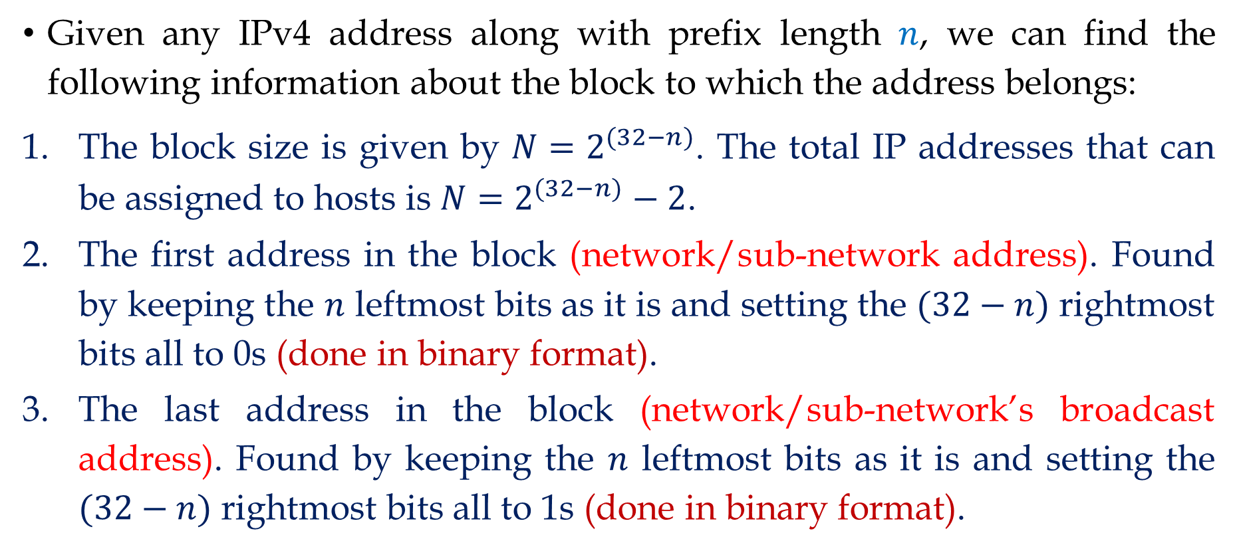
Extracting Information from IPv4 Address: 1st Technique
Given any IPv4 address along with prefix length $n$, we can find the following information about the block to which the address belongs:
The block size is given by $N=2^{(32−n)}$. The total IP addresses that can be assigned to hosts is $N=2^{(32−n)}−2$.
The first address in the block (network/sub-network address). Found by keeping the $n$ leftmost bits as it is and setting the $(32−n)$ rightmost bits all to 0s (done in binary format).
The last address in the block (network/sub-network’s broadcast address). Found by keeping the $n$ leftmost bits as it is and setting the $(32−n)$ rightmost bits all to 1s (done in binary format).

Slide 7
Extracting Information from IPv4 Address: 1st Technique (Cont.)

Slide 8


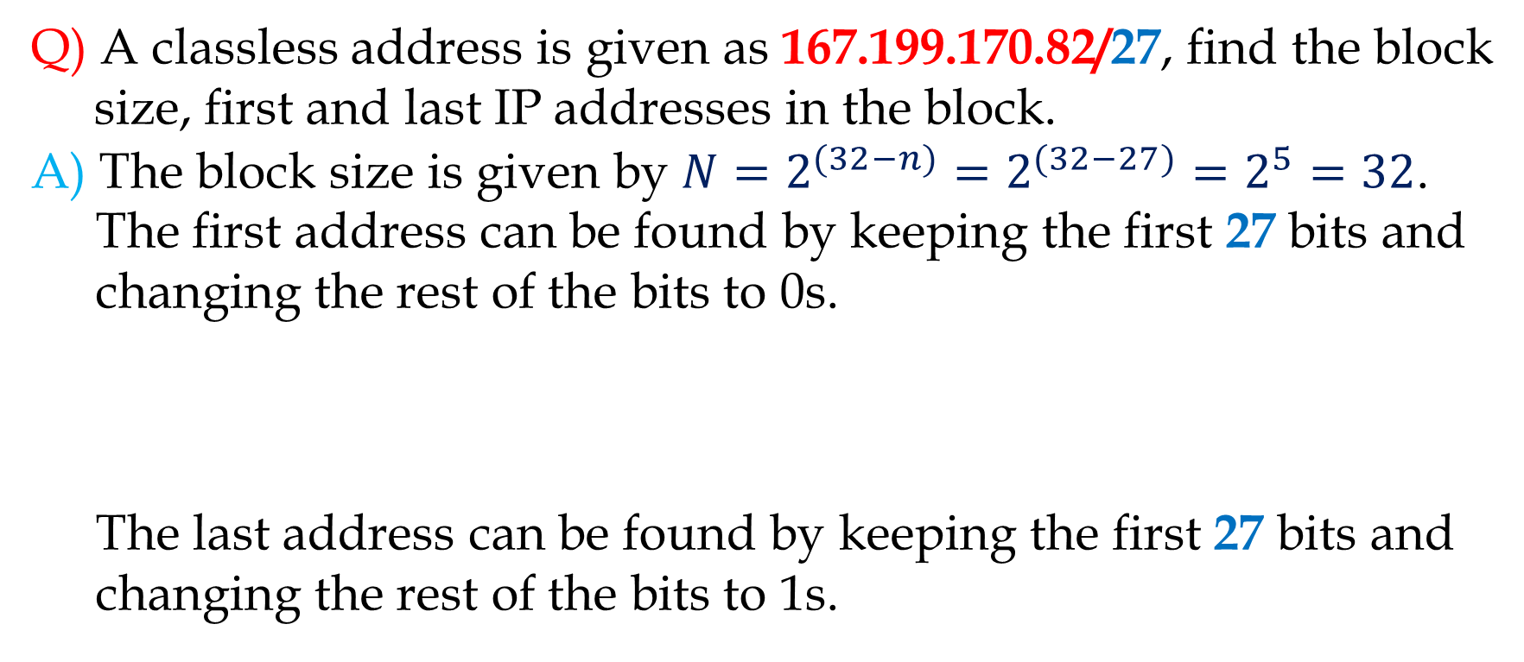
Extracting Information from IPv4 Address: 1st Technique (Cont.)
Q) A classless address is given as 167.199.170.82/27, find the block
size, first and last IP addresses in the block.
A) The block size is given by $N=2^{(32−n)}=2^{(32−27)}=2^{5}=32$.
The first address can be found by keeping the first 27 bits and changing the rest of the bits to 0s.
The last address can be found by keeping the first 27 bits and changing the rest of the bits to 1s.

Slide 9
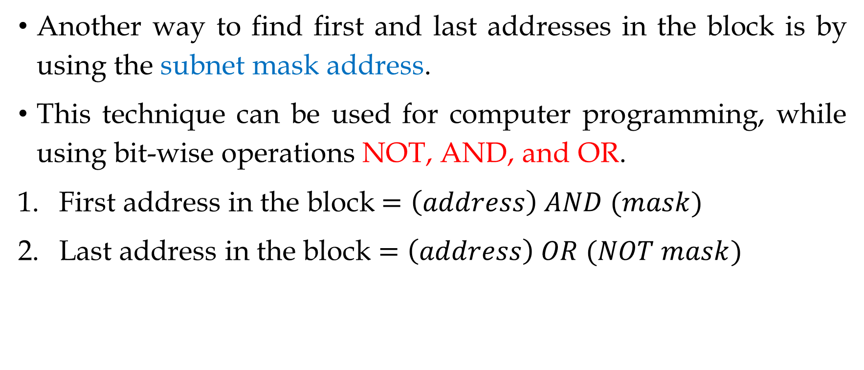
Extracting Information from IPv4 Address: 2nd Technique
Another way to find first and last addresses in the block is by using the subnet mask address.
This technique can be used for computer programming, while using bit-wise operations NOT, AND, and OR.
First address in the block$=\left(address\right) AND (mask)$
Last address in the block $=\left(address\right) OR (NOT mask)$

Slide 10
Extracting Information from IPv4 Address: 2nd Technique (Cont.)
Q) A classless address is given as 167.199.170.82/27, find block size, first and last addresses in the block.
A)
First address in the block = 167.199.170.64
Last address in the block = 167.199.170.95

Slide 11
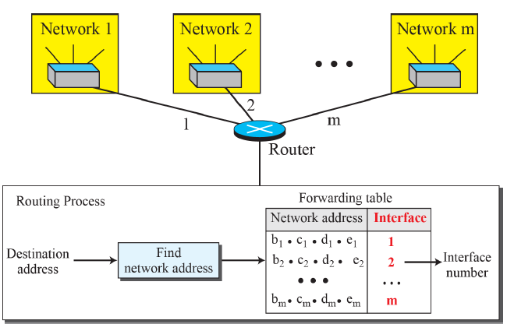
The Network Address
Given any IP address, why is it required to find the network address?
When a packet arrives at the router from any source, the router needs to know to which network the packet should be sent, hence finding the interface through which the packet should be sent.

Slide 12
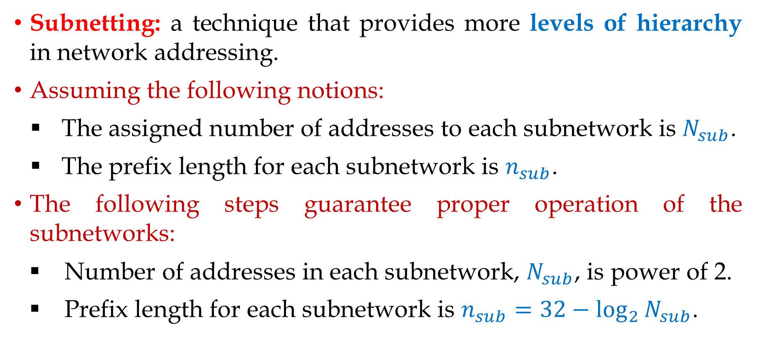
Subnetting
Subnetting: a technique that provides more levels of hierarchy in network addressing.
Assuming the following notions:
The assigned number of addresses to each subnetwork is $N_{sub}$.
The prefix length for each subnetwork is $n_{sub}$.
The following steps guarantee proper operation of the subnetworks:
Number of addresses in each subnetwork, $N_{sub}$, is power of 2.
Prefix length for each subnetwork is $n_{sub}=32−\log_{2}{N_{sub}}$.

Slide 13
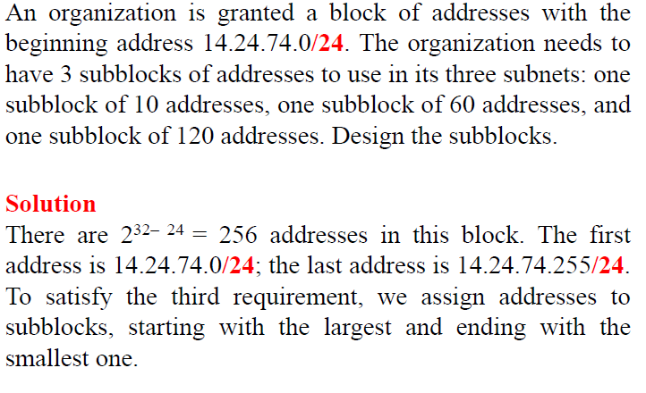
Subnetting (Cont.)
Example#01:

Slide 14
Subnetting (Cont.)

Slide 15
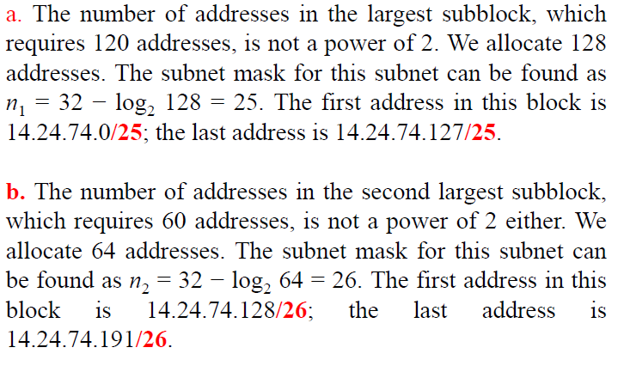
Subnetting (Cont.)

Slide 16
Subnetting (Cont.)

Slide 17
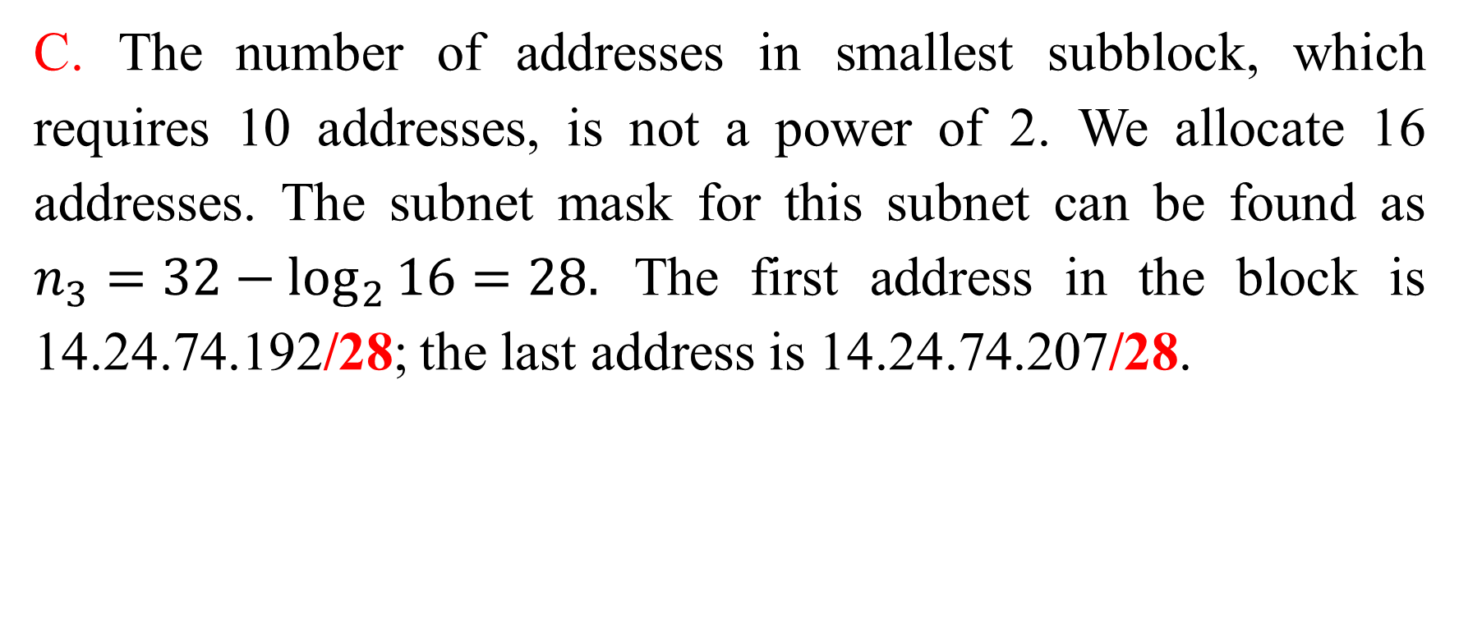
Subnetting (Cont.)
C. The number of addresses in smallest subblock, which requires 10 addresses, is not a power of 2. We allocate 16 addresses. The subnet mask for this subnet can be found as $n_{3}=32−\log_{2}{16}=28.$ The first address in the block is 14.24.74.192/28; the last address is 14.24.74.207/28.

Slide 18
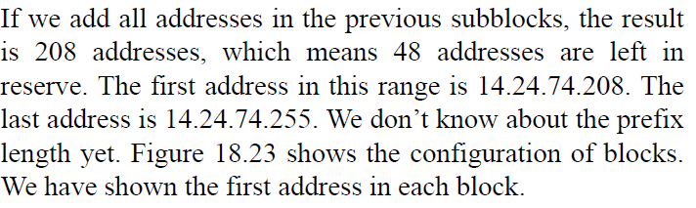
Subnetting (Cont.)

Slide 19
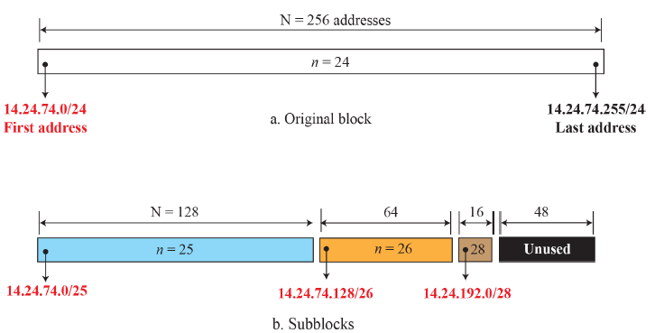
Subnetting (Cont.)

Slide 20
Subnetting (Cont.)
Subnetting a larger network into same sized sub-networks.

Slide 21
Network Address Translation
Network Address Translation (NAT): a technology that can provide the mapping between the private and universal IP addresses.
Private Addresses: is an IPv4 special address that has four assigned blocks for this purpose, which are 10.0.0.0, 172.16.0.0, 192.168.0.0 and 169.254.0.0.

Slide 22
Network Address Translation (Cont.)
NAT Working mechanism:
NAT is used to assign private IP address to a group of computers to have their own internal communication among themselves.
NAT translates the private IP address into a public IP address for external communications on the internet, and vice versa is correct.
The above described setup requires a NAT-capable router that runs NAT software.
The universal address should be at-least one.

Slide 23
Network Address Translation (Cont.)
NAT implementation

Slide 24
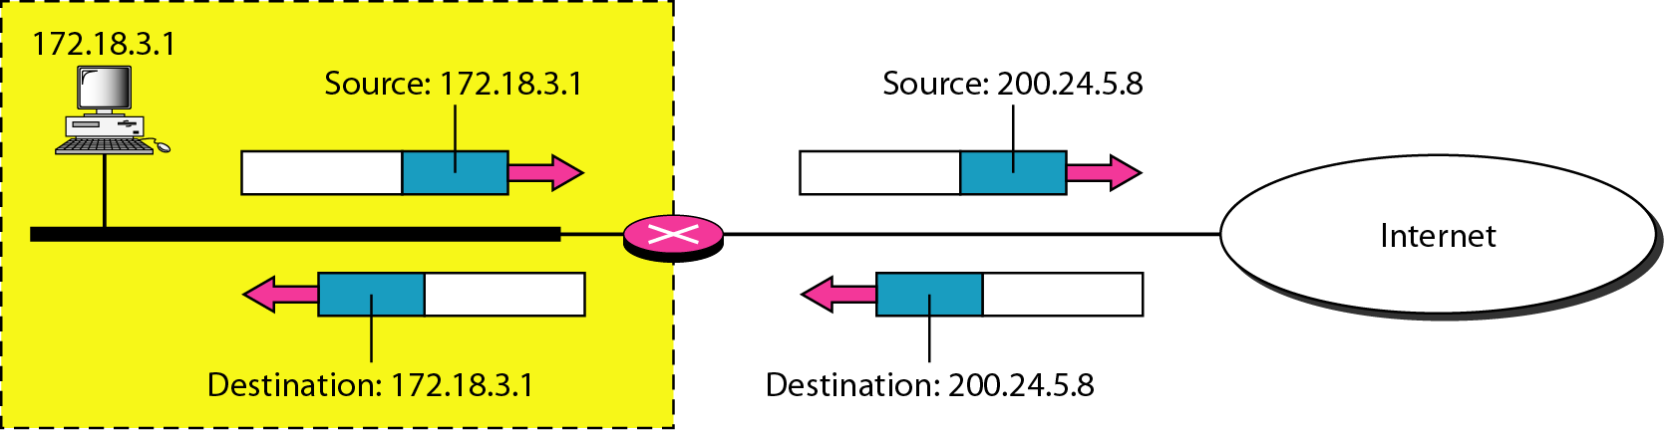
Network Address Translation (Cont.)
The private network uses private addresses.
The router that connects the network to the global address uses one private address and one global address.
The private network is invisible to the rest of the Internet.
Rest of the Internet sees only the NAT router with address 200.24.5.8.
Addresses in a NAT

Slide 25
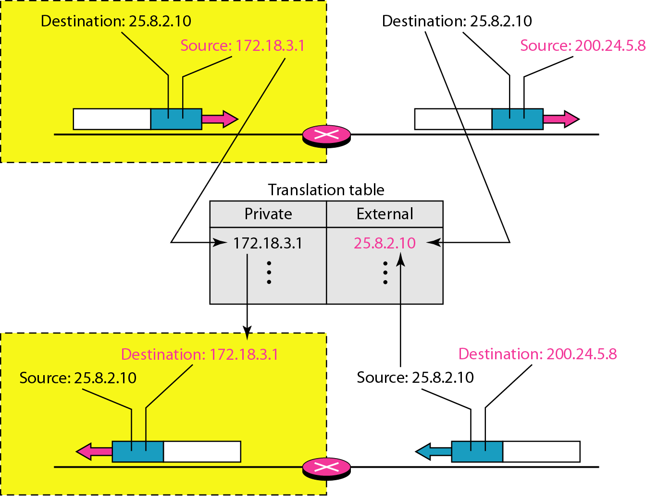
Network Address Translation (Cont.)
NAT Working mechanism (Cont.):
The private address in invisible to rest of the world.
The rest of the internet sees only the NAT router with the universal address.
NAT router uses a translation table to maintain mapping of addresses.
In the table, both IP addresses and port addresses are used.

Slide 26
Network Address Translation (Cont.)
To allow many-to-many communication between hosts in private networks and the external internet nodes while eliminating any kind of ambiguities, we use both IP addresses and port addresses in a five-column NAT translation table.
Note: for this five-column NAT translation to work, the port addresses must be unique.
Five-column translation table

Slide 27
Network Address Translation (Cont.)
Q) In the five-column NAT mechanism, why use a unique port address to identify the destinations within a private network if we already have a unique set of private IP addresses?

Slide 28
Thank You!

